Slide 1
Teletherapy and Other Virtual Supports
May 19, 2020

Slide 2
Teletherapy and other virtual Supports
Addressing Attendance, Mental Health Support, and the Return to Brick and Mortar
Vicki Koller, LCSW
Managing Officer of School Social Work Services
Pinellas County Schools
kollerv@pcsb.org

Slide 3

About our host
Currently the Pinellas County Schools Managing Officer of School Social Work Services.
Has been leading the department of 125 School Social Workers since August 2019.
Working in the social work field for over 29 years, and has been a Pinellas County School Social Worker the last 19 years.

Slide 4
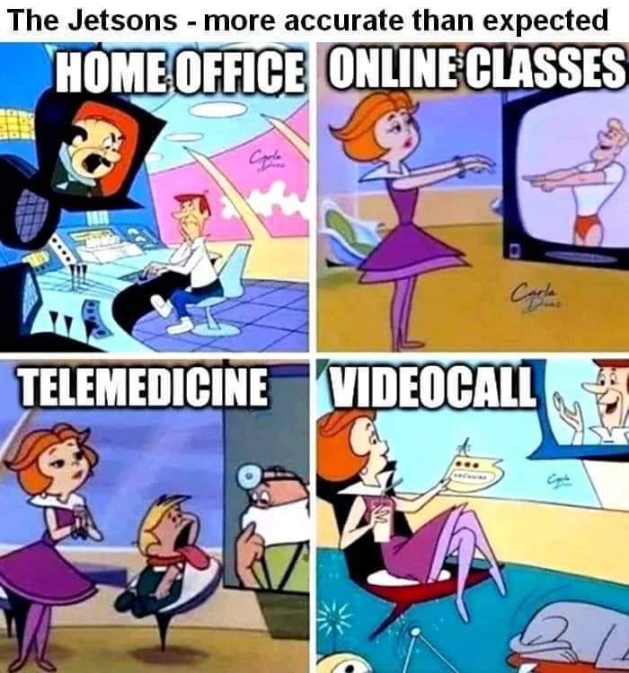
The Jetsons - more accurate than expected

Slide 5

OverVieW
Attendance
Student Engagement
Counseling as a related service
Crisis Response
Return to Brick and Mortar

Slide 6

Attendance During CoVID-19
Child Study Teams (CST) protocol
Define attendance
Gather data both baseline and historical
Student engagement
Facilitate provisions of basic needs

Slide 7
Students are considered “present” if they have engaged in the course in any way on the specific date:
Answering the attendance poll question
Submitting an assignment
Watching videos, live lessons or downloading work
Posting information in the MS Teams site such as a response in the General Channel
Emailing the teacher
Or other forms of academic interaction not included above
Students may log on to the computer any time during the 24 hours of the day to be counted present.
Teachers should have completed attendance in Focus for the previous day by 9am each day.

Slide 8

Child Study Team Members
Basic Team: Administrator, DMT, School Social Worker, School Counselor
Additional Team Members:
Nurse, School Psychologist, Behavior Specialist, Family-Community Liaison, Teachers, etc.
ROLES
Coordinator
Facilitator
Note Taker
Data Manager
Interventionists
Communicator

Slide 9
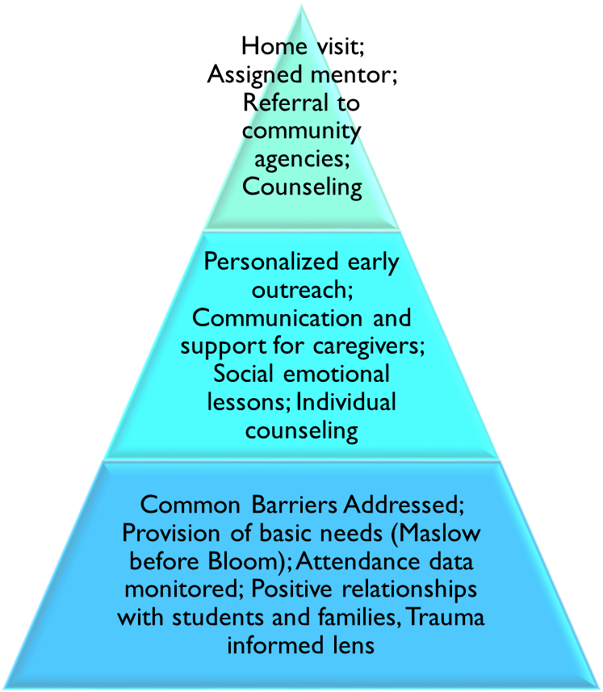
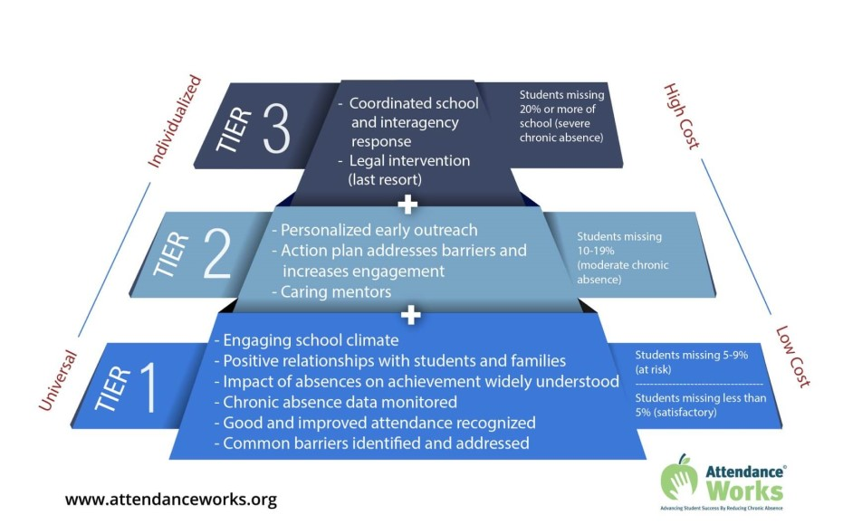
Attendance-MTSS
During Distance learning
Coordinated School and interagency response

Slide 10
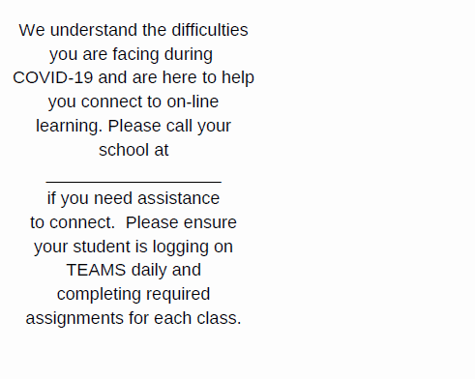
Sample Posters

Slide 11

Home VisITS
Safety first
Case by Case
Purpose
Safety concern
  DCF or Law Enforcement

Slide 12

Student Engagement Strategies during Distance learning
Consider the following:
Funding availability (School internal/discretionary accounts, SIP, Community, PTA etc.)
Strategies that best support student engagement for their school community
Implementation for successful strategy execution (e.g. staff member responsible, timelines, etc.)
Communication plans to advertise and share with all stakeholders
Rewards and incentives that will motivate increased attendance and academic engagement

Slide 13

RELATIONSHIPS! RELATIONSHIPS! RELATIONSHIPS!

Slide 14
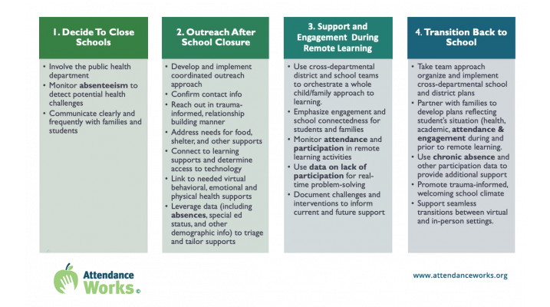
Key Concepts for Leveraging Chronic Absence During the Coronavirus Pandemic

Slide 15
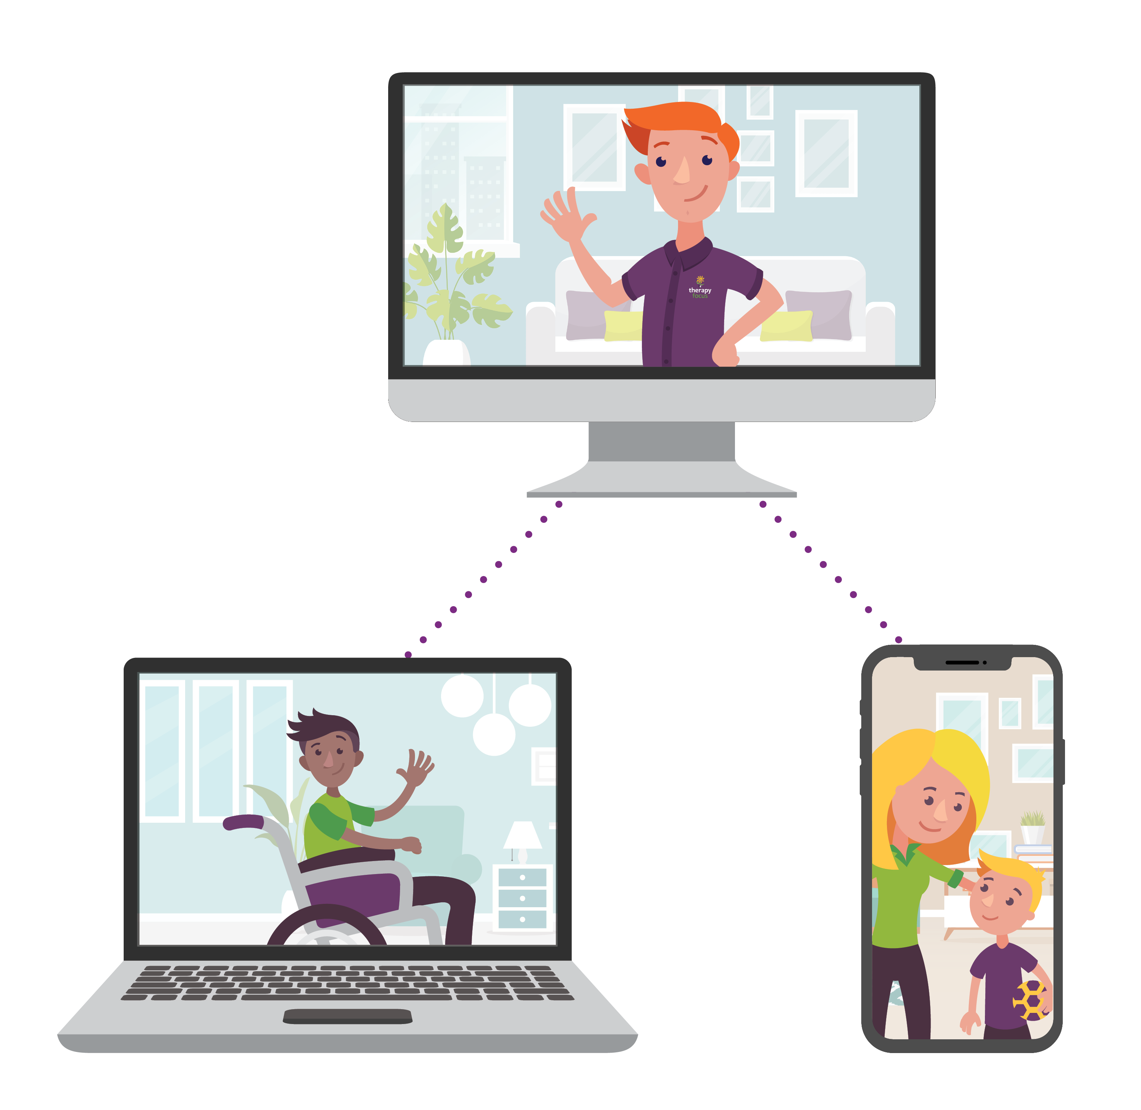
Counseling as a related service
Students that have counseling as a related service on their IEP
Students that have been assessed or met Baker Act criteria
Students that may have suffered a trauma
Students without an IEP that you were working with prior to quarantine

Slide 16
Crisis response during covid-19
Assess for risk of suicide
Providing support after a loss
Create flow chart
Plan for after hours concerns
Create process for follow up
Identify crisis lead
Create crisis team
Communicate referral process
Triage
Provide support
Debrief with team

Slide 17

Role Of Student Services 2020-2021
Topics to Consider During Planning
Staff Self-Care
Community Resources
Student and Family Engagement
Attendance
Counseling Supports
Crisis Support/Coping with Trauma

Slide 18

Social Worker I am by: Vicki Koller, LCSW
I will Counsel you in a room
I will Counsel you now on Zoom
I will Counsel you from a car
I will Counsel you from a far
I will Counsel you with a mouse
I will Counsel you while at my house
I will Counsel you here and there
I will Counsel you because I care
Do not worry, breathe, and rest
I will do my very best!

Slide 19

QUEStions?
Thank you for your time and attention!
You are welcomed to contact me at Kollerv@pcsb.org
Wishing you a wonderful summer making moments into memories!

Slide 20

SSW Telehealth Services
Best Practices

Slide 21

Guiding Principles
NASW COVID 19 Ethics
Technology in Social Work Practice
Professional Boundaries
Ethical Exceptions for Social Workers in Light of the COVID-19 Pandemic and Physical Distancing
Voicemail Greeting

Slide 22

Establishing Safe Use of Technology & Boundaries
Use of district equipment
Social Media Policy
Office Hours
Outbound Messaging
Knowledge of platform
Contingency Plan
Disclosure
Consent
Organizational Norms
Self-Care

Slide 23

Google Voicemail Script
You have reached the Google voicemail for ________, School Social Worker with Hernando County School District. If you are experiencing a medical or mental health emergency, please hang up and dial 911 or go to your nearest emergency room. My office hours are ______ to ______ , Monday through Friday. Please leave a message including your name, name of your student, and how I may help you. I will return your call within 24 hours.
Thank you.

Slide 24
Considerations...
Social Worker
Student
Technology
Security
Reliability
Competency
Boundaries
Organizational Practices
Healthy Relationships
Documentation
Risks
Consent
Access
Equipment
Space
Time
Appropriateness
Development
Compliance

Slide 25

Successful Engagement Online
Access to resources
Ability to Participate
Upfront disclosure of associated risks and guidance on creating appropriate space for remote support services
  Check List
  Consent
Informed Consent for Telehealth Services
I understand that “telehealth” includes secure video conferencing, emails, telephone conversations, and education using interactive audio, video, or data communications...
Checklist: Provision of Telehealth
This checklist may serve as a useful tool for school social workers to ensure the requirements of Florida regulations on the Standards of Telehealth have been met. This document is provided solely for informational and educational purposes and should not be considered to be legal advice.

Slide 26
Medicaid Telehealth Update (schools)
Must be real time, with BOTH two-way interactive audio and video
Telephone or electronic (email) based contact is not billable
The recipient (and the legal guardian) must be present for the duration of the service being provided
Documentation of Telemedicine must be kept in the progress note for each service
If you are entering Telemedicine services that were provided via audio AND video: (Currently Billable)
In the progress note please start your notes off with ONE of the following entries:
Telemedicine via uninterrupted audio and video, parent/guardian present...

Slide 27
Progress Notes for Not Currently Billable
If you are entering Telemedicine services did NOT contain BOTH audio AND video, but was conducted via telephone only or email, please select:
“Non-Billable Therapy or Session” from the Service Code dropdown.
It will allow us to search for services to bill if policy is changed to allow for more services to be claimed.
Begin Your Progress Notes with:
Telemedicine via uninterrupted audio and video, parent/guardian NOT present
Telemedicine via telephone, parent/guardian present
Telemedicine via telephone, parent/guardian NOT present
Telemedicine via email

Slide 28
Informing Practice
SAMHSA Guidelines
Providing School MH Support Online
Telehealth Toolbox for School Personnel
National Center for School Mental Health
School Social Work Association of America
School Social Work Network

Slide 29
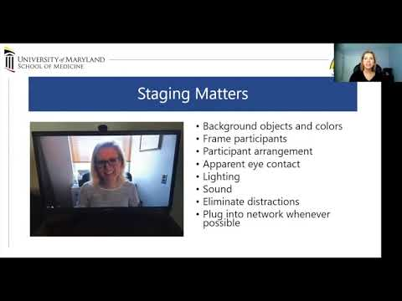
Telemental Health 101
National Center for School Mental Health
Jennifer Cox, LCSW-C, Director of the University of Maryland School Mental Health Program

Slide 30
Sources
NASW
https://www.socialworkers.org/Practice/Infectious-Diseases/Coronavirus
https://www.socialworkers.org/LinkClick.aspx?fileticket=lcTcdsHUcng%3d&portalid=0
https://www.socialworkers.org/LinkClick.aspx?fileticket=uEWY0sNANmU%3d&portalid=0
The New Social Worker
https://www.socialworker.com/feature-articles/ethics-articles/ethical-exceptions-social-workers-in-light-of-covid-19-pandemic-physical-distancing/
Master's in Counseling
https://www.mastersincounseling.org/counseling/voicemail-greetings/
SAMHSA
https://www.integration.samhsa.gov/operations-administration/practice-guidelines-for-video-based-online-mental-health-services_ata_5_29_13.pdf
School Social Work Network
https://schoolsocialwork.net/about/
National Center for School Mental Health
University of Maryland School of Medicine
http://www.schoolmentalhealth.org/COVID-19-Resources/

